Slide 1

Operation Instructions
for the Professional Visitor Front-end of the 4th Digital Trade Expo
中国，杭州 Hangzhou , China

Slide 2
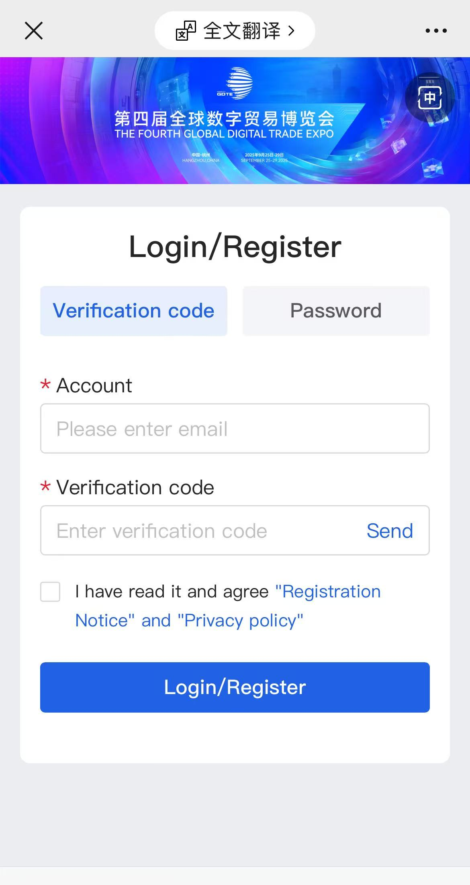
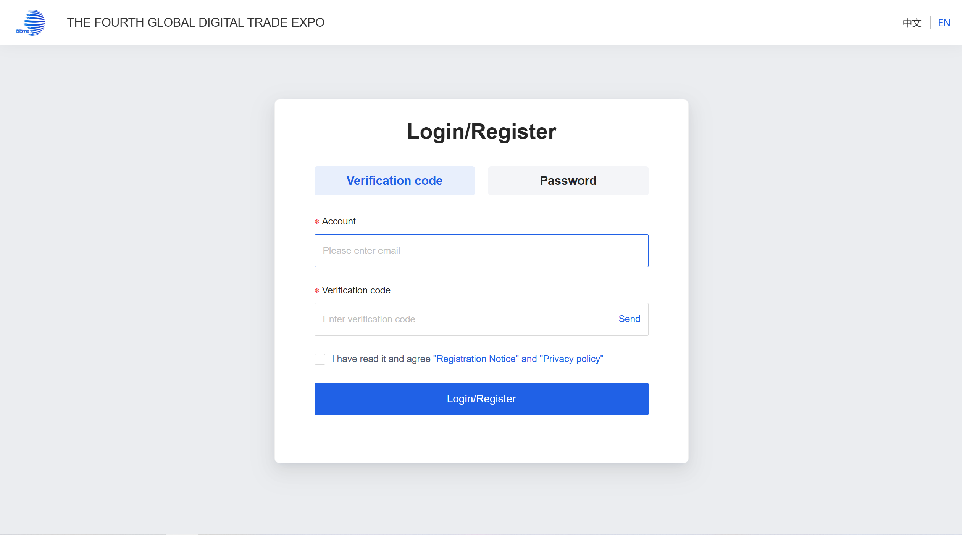
I. Register Account
1、Access the website: https://www.gdteonline.com and go to the Professional Visitor Login/Register page. Enter your email address and obtain the verification code to register for an account.
Note: If you are a business guest invited by a group contact, please use the invitation link or scan the invitation QR code to register.
PC
phone

Slide 3
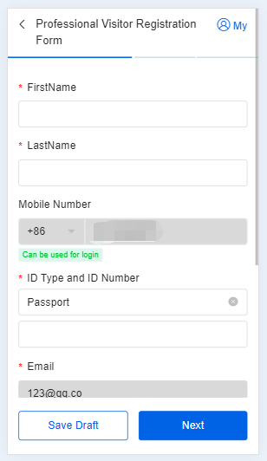
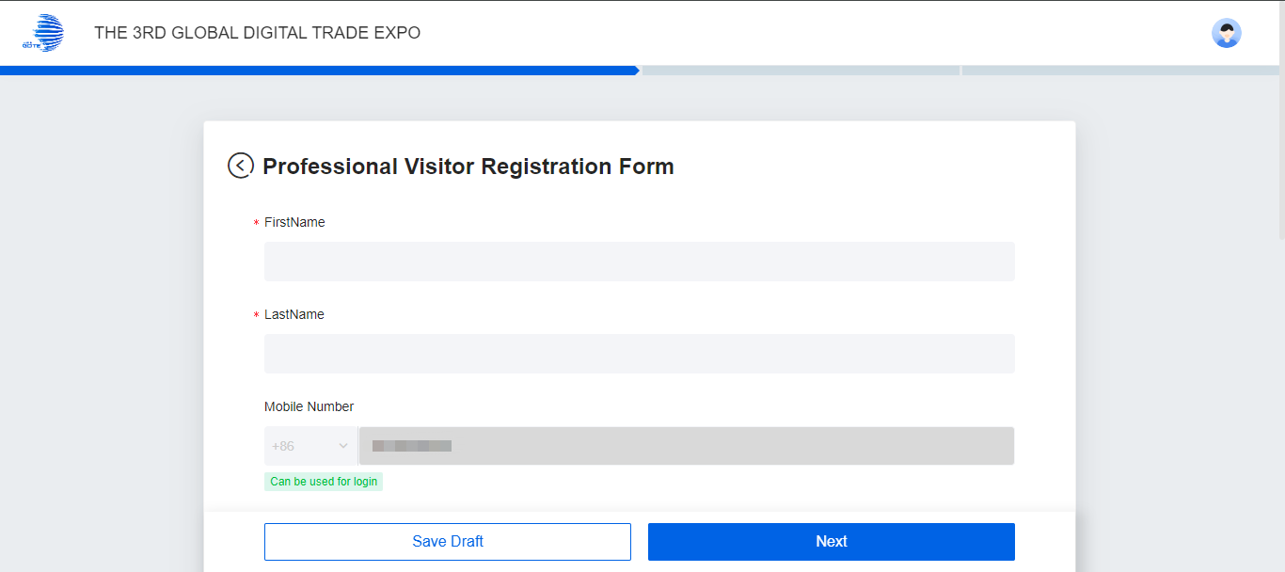
I. Register Account
2、Fill in the registration information for professional visitor and click "Next"；
PC
phone

Slide 4
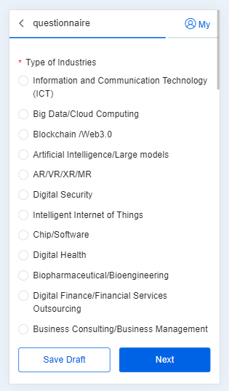
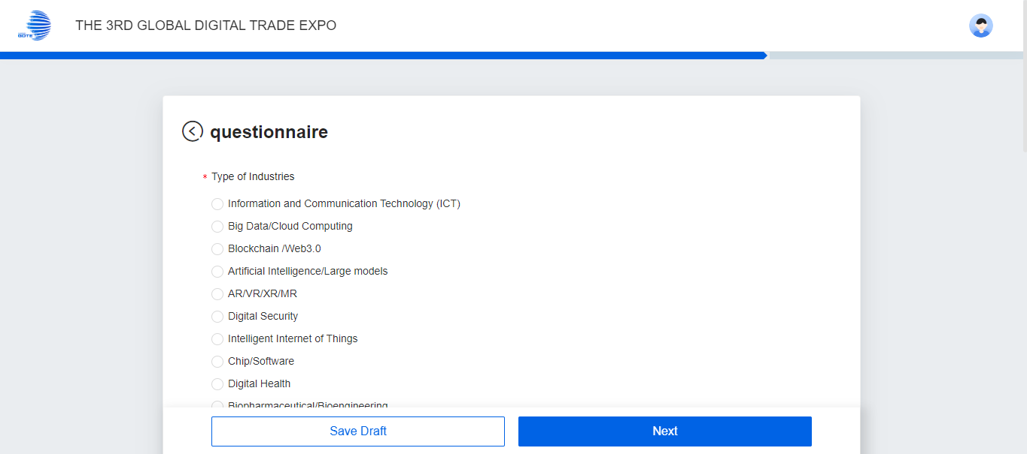
I. Register Account
3、After selecting the relevant contents in the questionnaire section, click "Next"；
PC
phone

Slide 5
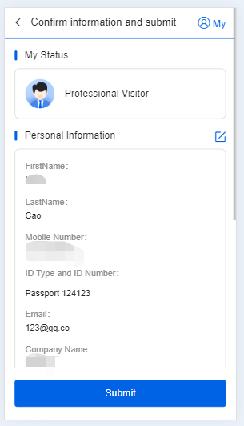
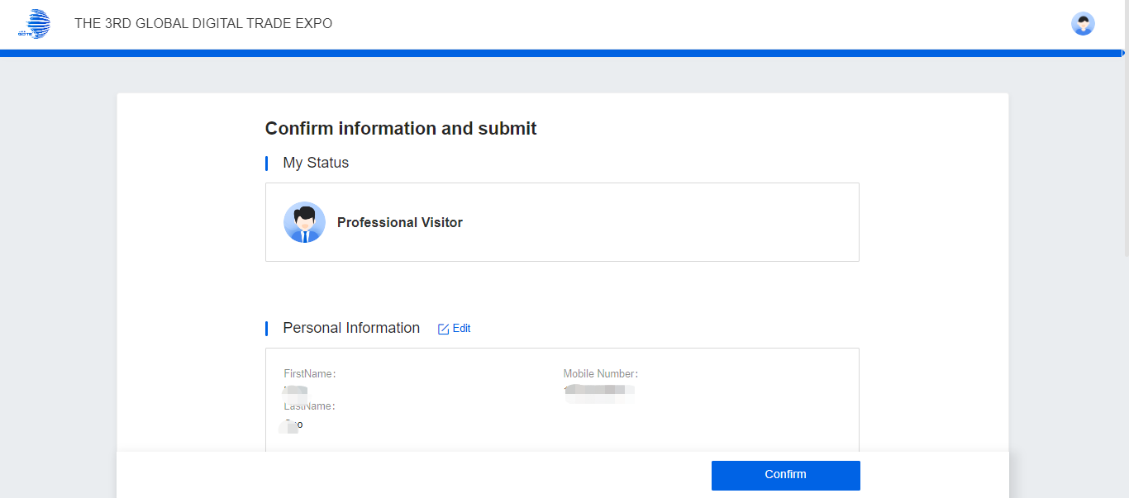
I. Register Account
4、After confirming that the information is correct, click "Confirm" to submit.
PC
phone

Slide 6
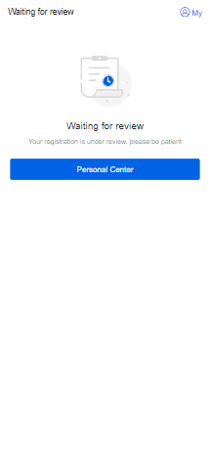
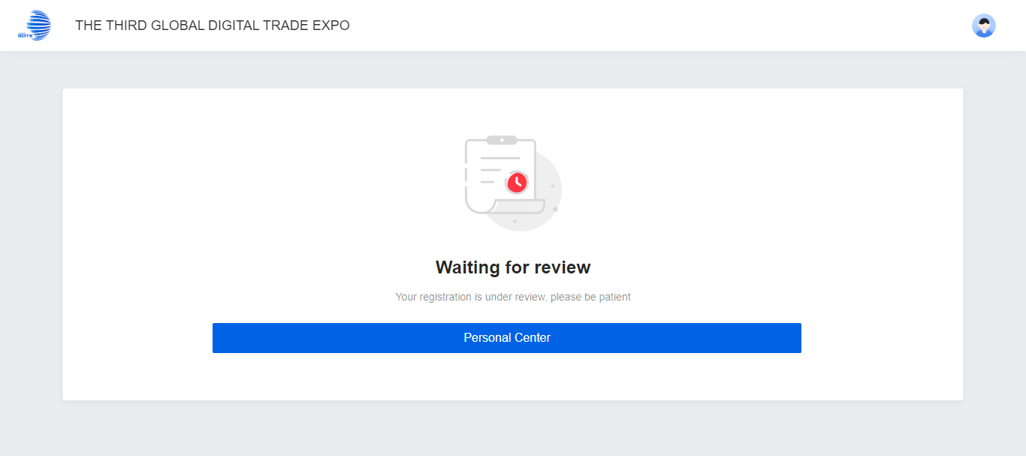
I. Register Account
5、After submitting the information, it will enter the "Waiting for Review" page.
The Fourth Global Digital Trade Expo
PC
phone

Slide 7
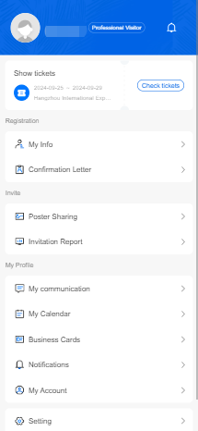
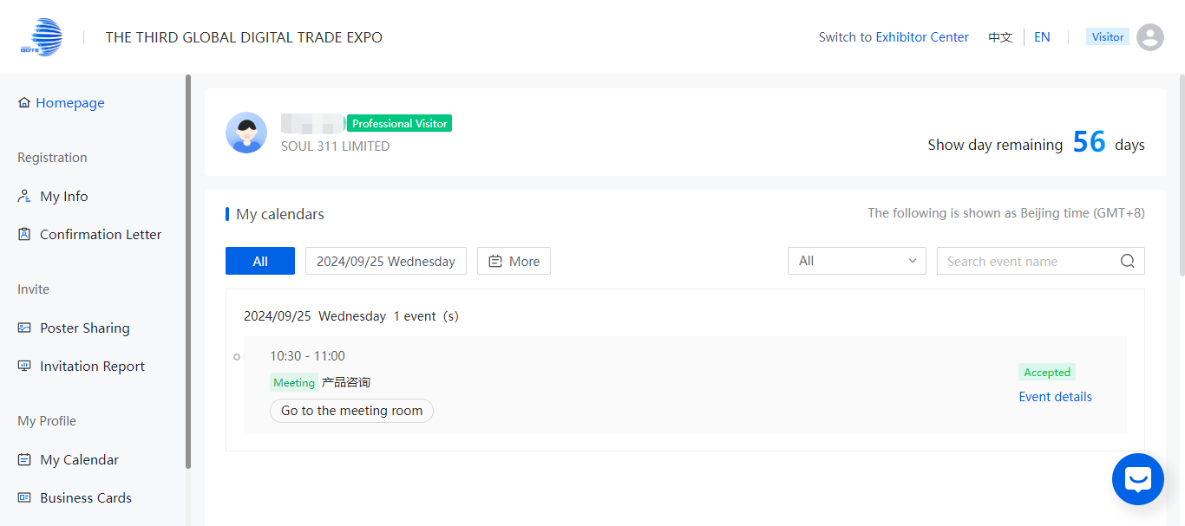
II. Log in
Click "Personal Center" and log in with your phone/email verification code to check the review status.
The Fourth Global Digital Trade Expo
PC
phone

Slide 8
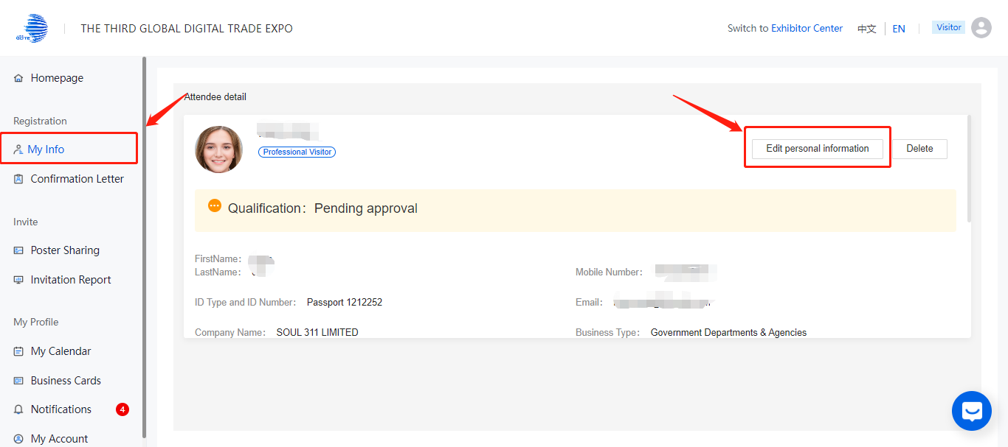
III. My Info
On the "My Info" page, professional visitor can click on "Edit Personal Information"
to edit their professional information, and then click "Save" after completion.
The Fourth Global Digital Trade Expo

Slide 9
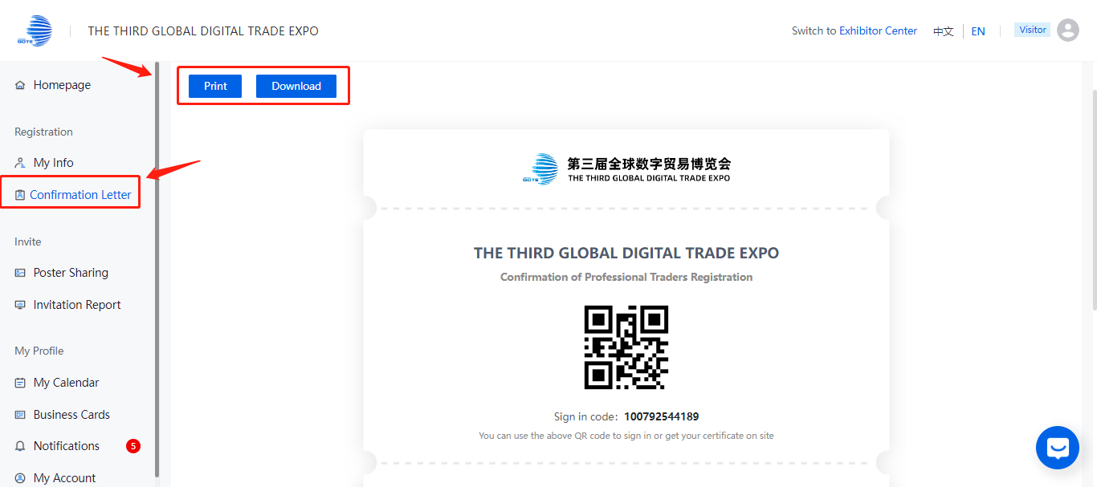
IV. Confirmation Letter
On the "Confirmation Letter" page, a professional visitor-exclusive registration confirmation letter will be generated after passing the review, which can be viewed, printed, and downloaded on this page.
The Fourth Global Digital Trade Expo
The Fourth Global Digital Trade Expo

Slide 10
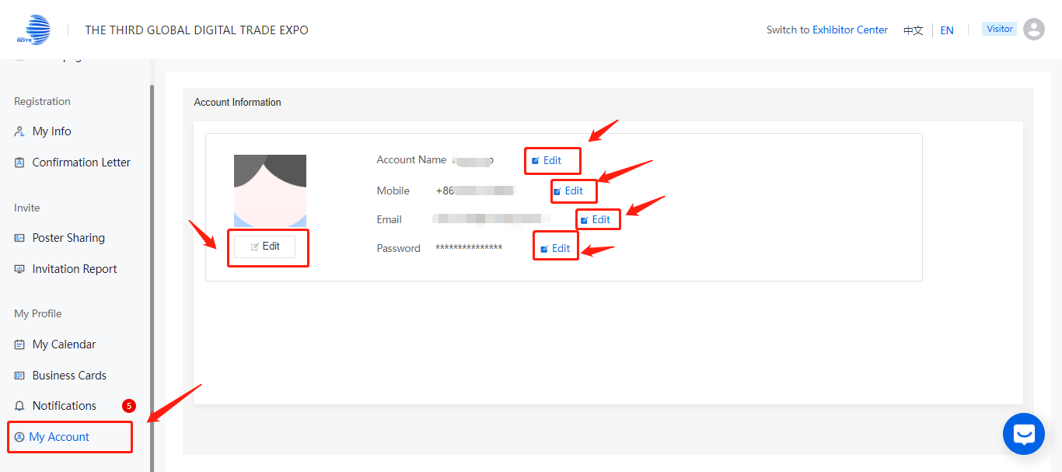
V. My Account
On the "My Account" page, professional visitor can modify their login phone number, email, and password settings.
Tips: Upon login/registration, the system defaults to saving the current user and group code data. To switch accounts, log out or use a different browser/device.
The Fourth Global Digital Trade Expo

Slide 11


Welcome to the 4th Global Digital Trade Expo!

